Slide 1



How does Bike-Share Navigates Speedy Success ?
Hiten Verma

Slide 2
Case Study: Cyclistic – Bike Share
About the company :
In 2016, Cyclistic launched a successful bike-share offering. Since then, the program has grown to a fleet of 5,824 bicycles that are geotracked and locked into a network of 692 stations across Chicago. The bikes can be unlocked from one station and returned to any other station in the system anytime.
Until now, Cyclistic’s marketing strategy relied on building general awareness and appealing to broad consumer segments. One approach that helped make these things possible was the flexibility of its pricing plans: single-ride passes, full-day passes, and annual memberships. Customers who purchase single-ride or full-day passes are referred to as casual riders. Customers who purchase annual memberships are Cyclistic members.

Slide 3
Business Goal : Design marketing strategies aimed at converting casual riders into annual members
Dataset : https://divvy-tripdata.s3.amazonaws.com/index.html
To solve this problem , the steps involved are: Prepare, Process, Analyze, Share and Act.
For this Case-Study (12 Months Data)
Data is from 1st-Jan-2021 to 31st-Dec-2021

Slide 4
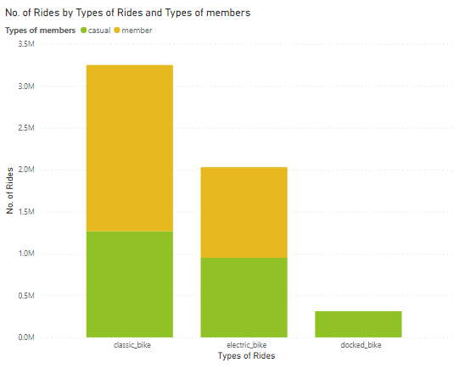
Understand the Data:
How do annual members and casual riders use Cyclistic bikes differently?
Annual member (30,65,970) was higher than casual (25,28,946).﻿﻿ ﻿﻿ ﻿﻿
Annual member accounted for 54.80% of Total of rides.﻿﻿ ﻿﻿ ﻿

Slide 5
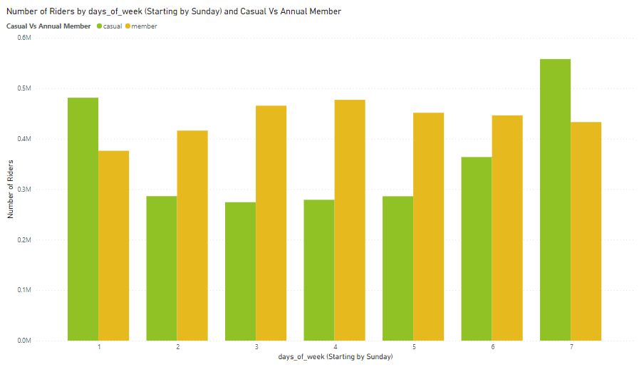
Rides Weekly Preferences :
﻿
﻿Average Number of Riders was higher for Annual member (4,37,996) than casual (3,61,278).
Number of Riders for Annual member and casual diverged the most on Wednesday, when member were 1,98,030 higher than casual.﻿

Slide 6
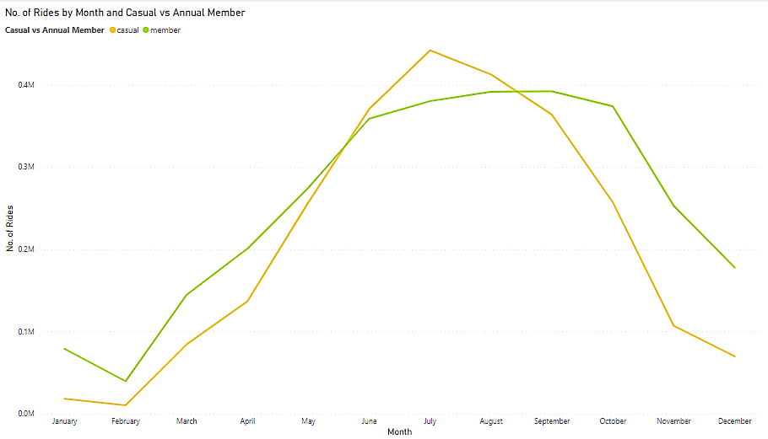
Rides Per Month:
Riders have almost the same trend i.e. peak during the summer season
No. of Rides for Annual member and casual diverged the most when the Month was November, when Annual member were 1,46,129 higher than casual.

Slide 7
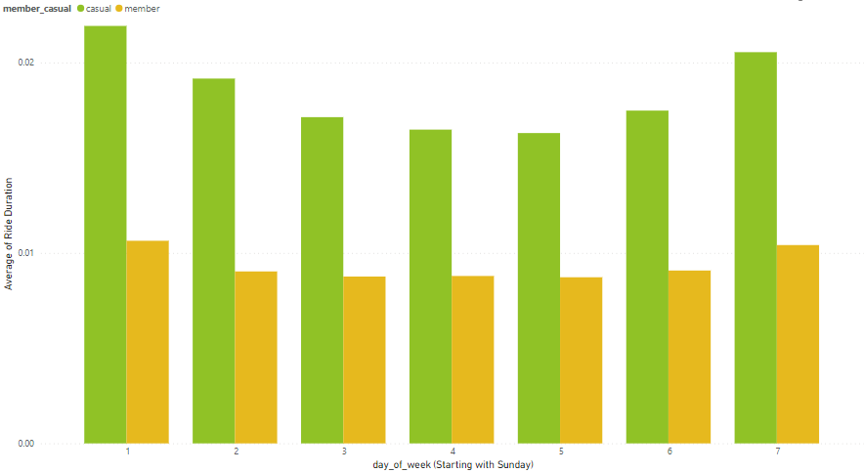
Average Ride Duration:
Bikes are mostly occupied by casual riders as a comparison to annual member riders

Slide 8
Observation :
Casual riders use bikes for leisure time and activities, where they are most interested during the summer season over the weekends and at 4-6 pm.
While the Annual member riders are more loyal customers who use bikes daily for commuting purposes.
The Number of rides are maximum on weekends for casual riders and there is decline of riders as winter approaches.
Annual members take better care of bikes in terms of timely return (within a day), they are consistent over the weekdays, and have rides uniformly at all geographical locations and are more consistent over all seasons during the year.
Even though the number of member riders are greater than the casual riders, the average usage of bikes by casual riders are almost double than those of member riders.

Slide 9
Recommendations :
We can introduce a “Weekend only memberships”, for casual riders to attract them into membership, where they not only gets to pay less but also gets to keep bikes for longer duration(more than a day).
Increase the charge for one-time users during evenings and weekends.
Incorporate special benefits and incentives (Food coupons, holiday offers, health tracker etc) for annual member riders, to lure casual riders.
Marketing can be done on Weekends for casual riders to promote Cyclistic membership

Slide 10
Thank You!

